Slide 1
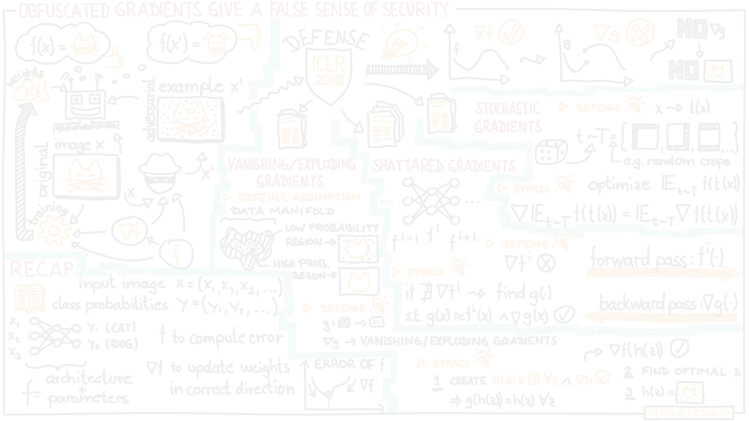
Machine Learning Security
Project #3
https://github.com/christianscano/MLSec-Project.git
Marco Ledda (70/90/00471) Christian Scano (70/90/00346)

Slide 2
Project Introduction
The project aims to re-evaluate 5 models picked from RobustBench with a different attack algorithm (they used AutoAttack)
We chose the CIFAR-10 leaderboard with the threat-model set to L-infinite norm.
The attack chosen to re-evaluate the models is Fast Minimum-norm (FMN) by Pintor et al.
At the end, we explain the results and provide some motivations on why some adversarial samples did not work properly, while others did.

Slide 3
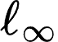
Models Overview
Dataset: CIFAR-10, =8/255, untargeted attack
Model | Clean Accuracy | AutoAttack Robust accuracy | Architecture
Wong2020Fast | 83.34% | 43.21% | PreActResNet-18
Engstrom2019Robustness | 90.83% | 69.24% | ResNet-50
Andriushchenko2020Understanding | 79.84% | 43.93% | PreActResNet-18
Cui2023Decoupled_WRN-28-10 | 92.16% | 67.73% | WideResNet-28-10
Chen2020Adversarial | 86.04% | 51.56% | ResNet-50

Slide 4
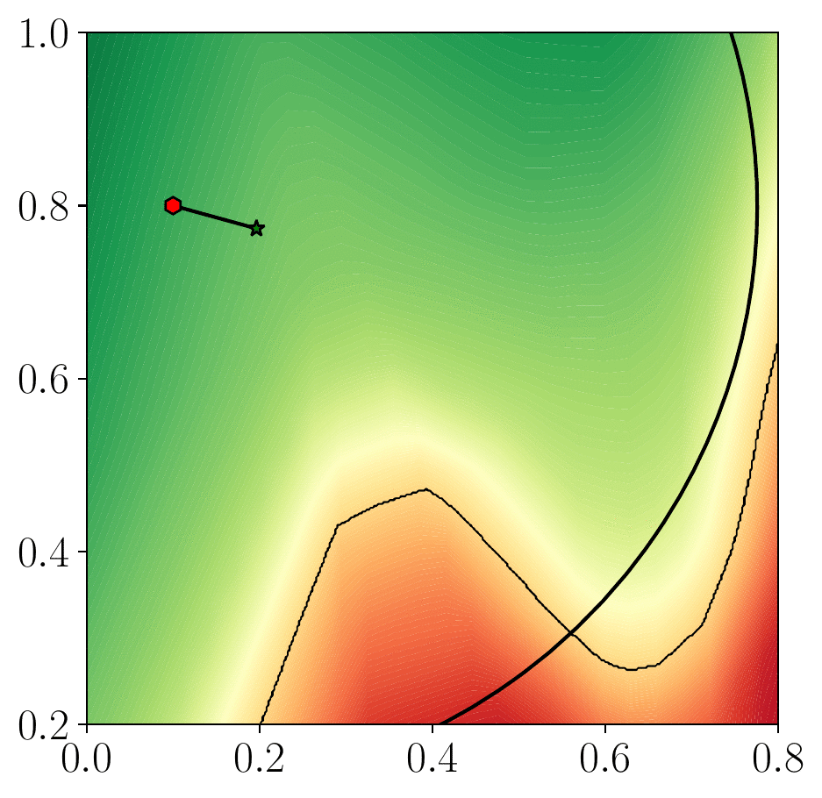
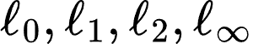
Fast Minimum-norm Attack
Fast minimum-norm attacks aim to mislead classification by finding the smallest input perturbation according to a given norm.
Features:
Fast convergence to good local optima
Works in different norms ( )
Easy tuning/robust to hyperparameter choice

Slide 5
Results of the attack
FMN has been tested on the five models presented before, considering the first 64 samples taken from CIFAR-10.
Model | FMN Robust Accuracy
Wong2020Fast | 42.19%
Engstrom2019Robustness | 46.88%
Andriushchenko2020Understanding | 43.75%
Cui2023Decoupled_WRN-28-10 | 67.19%
Chen2020Adversarial | 45.31%
Hyperparameters
Steps = 500
Max step size = 1.0
Gamma = 0.05

Slide 6
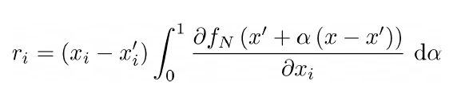
Explainability - Integrated Gradient
It improves the linear approximation by referring to a counterfactual baseline inputs.
This implements a method for local explanation of predictions via attribution of relevance to each feature.

Slide 7
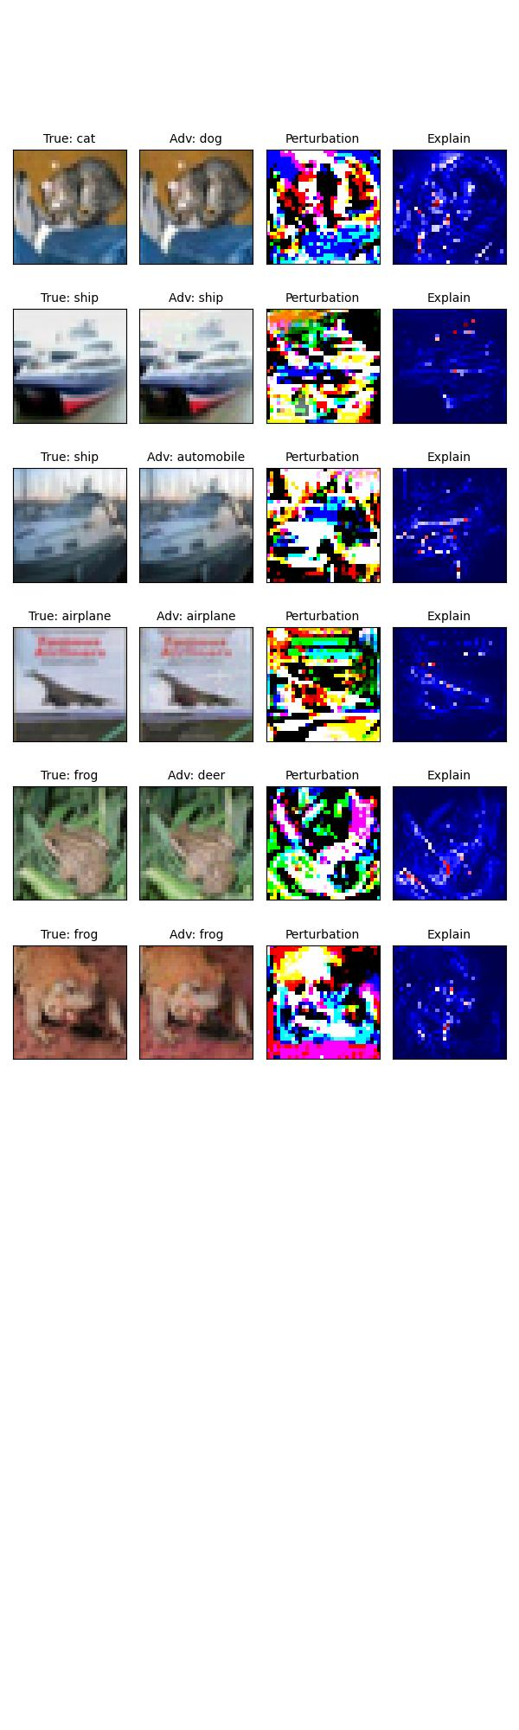
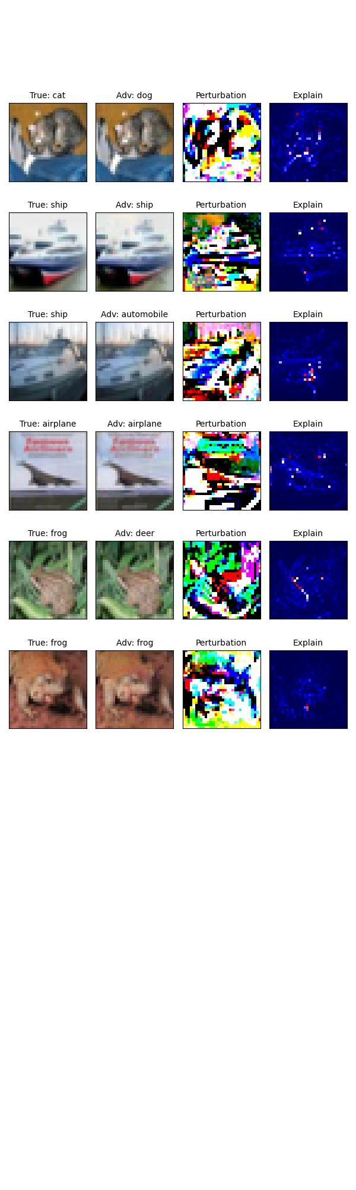
Explainability - Results
Model 1 - Wong2020Fast
Model 2 - Engstrom2019Robustness

Slide 8
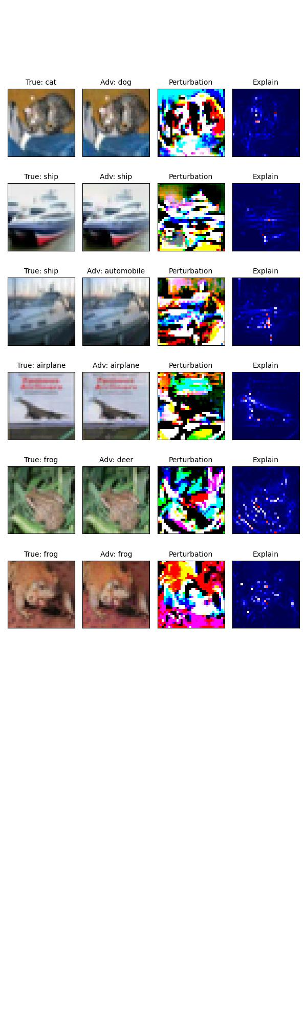
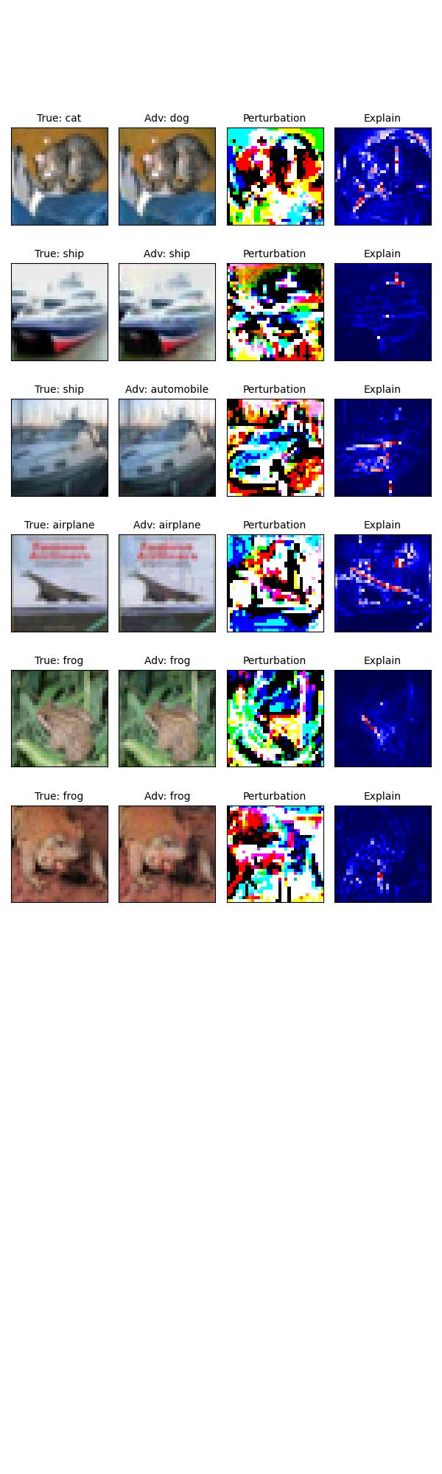
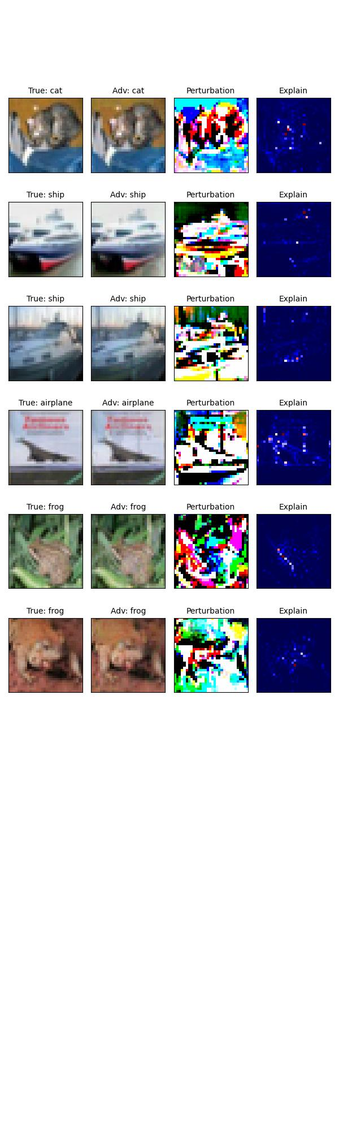
Explainability - Results
Model 5 - Chen2020Adversarial
Model 3 - Andriushchenko2020Understanding
Model 4 - Cui2023Decoupled_WRN-28-10

Slide 9
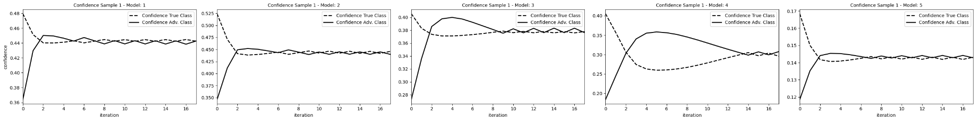
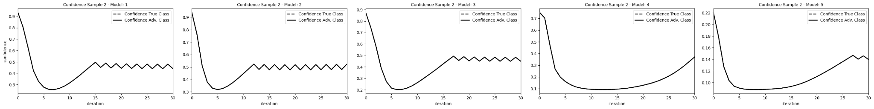
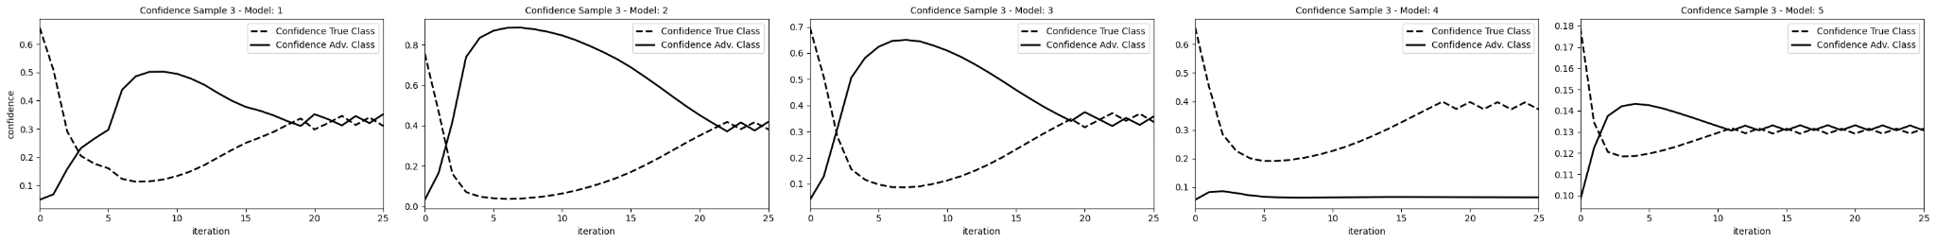
Attack convergence

Slide 10
Thanks for the attention

